Slide 1


Social Buzz
Content Analysis

Slide 2


Today's agenda
Project recap
Problem
The Analytics team
Process
Insights
Summary

Slide 3

Social Buzz is a fast growing technology unicorn that need to adapt quickly to it’s global scale.
Accenture has begun a 3 months POC (Proof of Concept) focusing on these tasks:
An audit of Social Buzz’s big data practice
Recommendation for successful IPO
Analysis to find Social Buzz’s top 5 most popular categories of content
Project Recap

Slide 4


Problem
Social Buzz has reached a massive scale of engagement data within recent years.
Over 100,000 posts are estimated to be made every day, or 36,500,000 posts annually. But how should this volume of data be handled?
Analysis to gain insight from Social Buzz’s top 5 most popular categories of content are expected.

Slide 5



Andrew Fleming
(Chief Technical Architect)
The Analytics team
Marcus Rompton
(Senior Principle)
Feliks Dexy
(Data Analyst)

Slide 6
Process
1
Data Understanding
2
Data Cleaning
3
Data Modeling
4
Data Analysis
5
Uncover Insights

Slide 7

Insights
973,645
pts
74,965
pts
84.6%
May, ‘21
Total Reaction Score
Top Category #1 is Animals
Positive Feedback Percentage
Highest Number of Posts
15 Reaction Type
16 Unique Categories
3 Different Sentiment
12 Months

Slide 8
Insights
A well-crafted user engagement's total interaction in recent years has reached 973,645 points, through 15 reaction types calculation, with the positive feedback excellence 84.6% out of three sentiment indicators.
With 86,293 points that occurred in May 2021 as the highest interaction score in 13 months. At the same time, the Animals category as the most popular content topic, ranked number #1 in contributing 74,965 points, selected out of 16 unique categories.
In this analysis, there were other indicators involved, for instance, 27.0% out of four types, Photos accounted for the most interactive content type, followed by the Animals category which contributed 27,128 points to Photos in recent years.

Slide 9
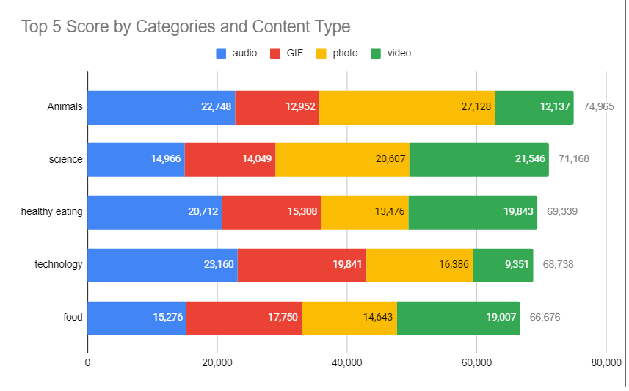

Slide 10
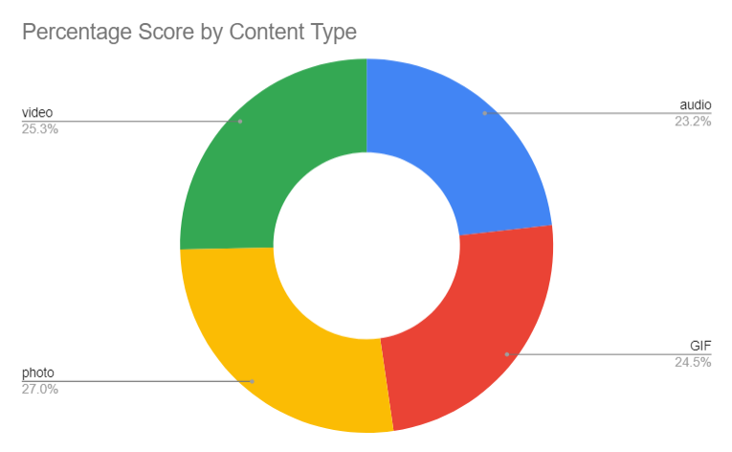
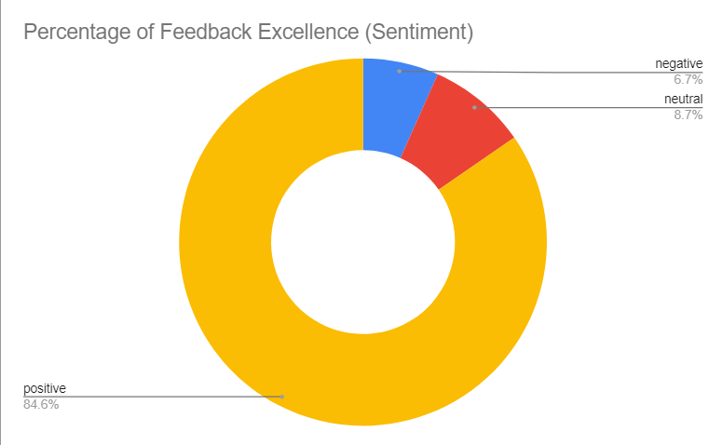

Slide 11
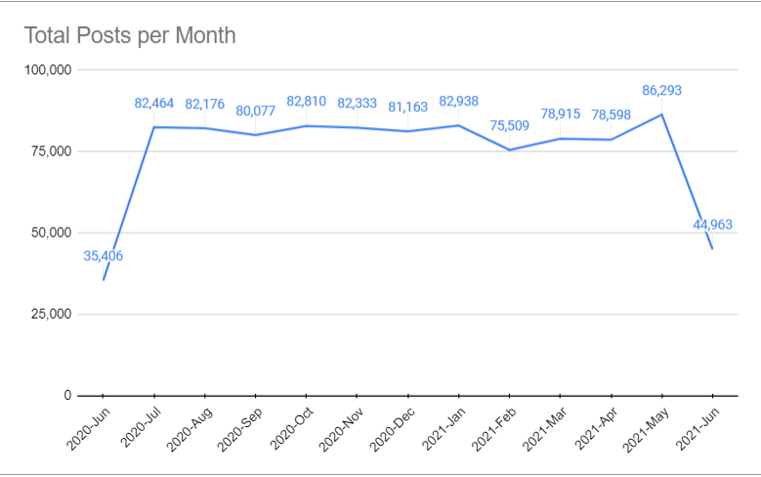

Slide 12

Analysis
Animals is Top Category #1 selected out of 16 unique categories, which contributing 74,965 points. While, at the same time, is sharing 27,128 points to Photos.
Insight
Summary
The user base shows a preference for Animals category with the Photo content type as the most popular content, followed by the Audio content of Technology on the second rank.
Next Steps
These noteworthy figures are insightful while, the interaction dynamics underlying this analysis expected to be taken into large-scale production in real–time. We can show you how to handle this massive data.

Slide 13

Thank you!
FEEL FREE TO LEAVE ANY QUESTIONS!

